Slide 1
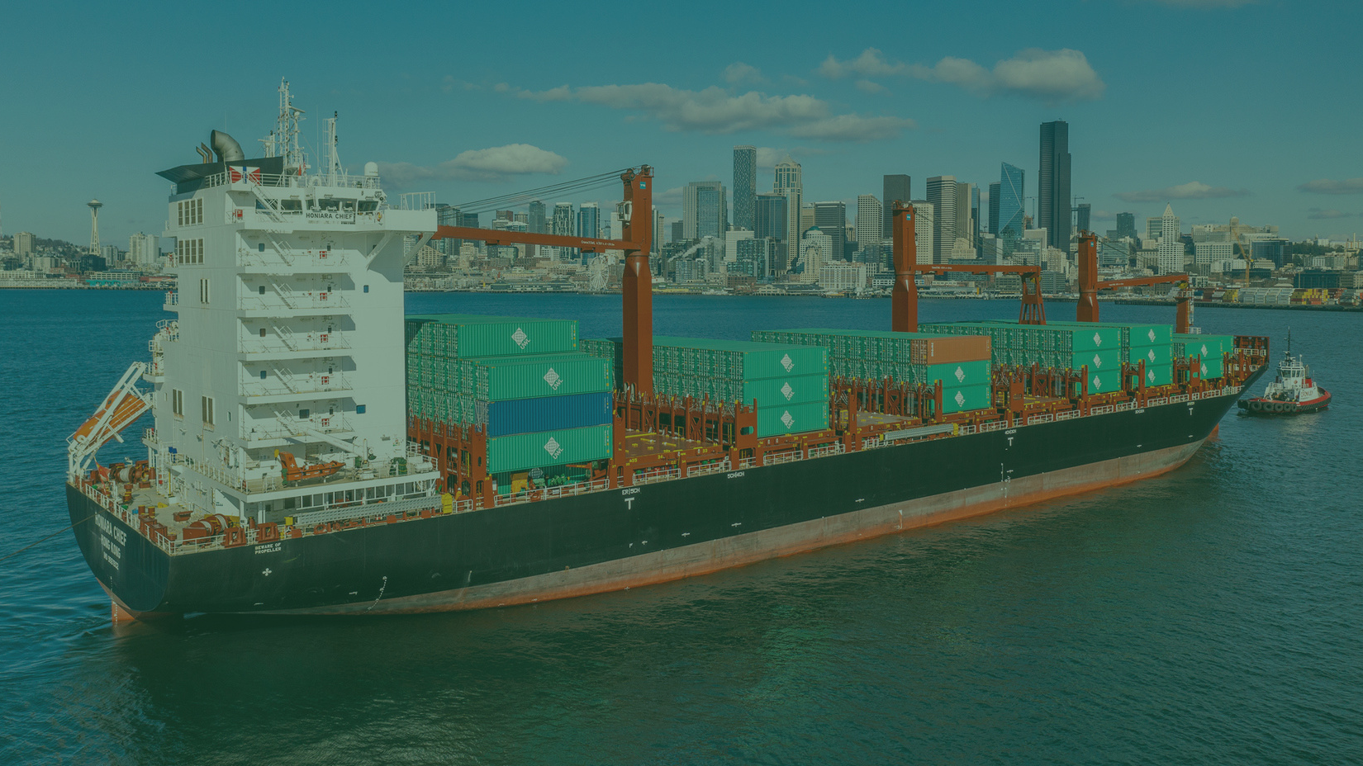
Supply Chain Solutions & Logistics Services - We're on it!

Slide 2
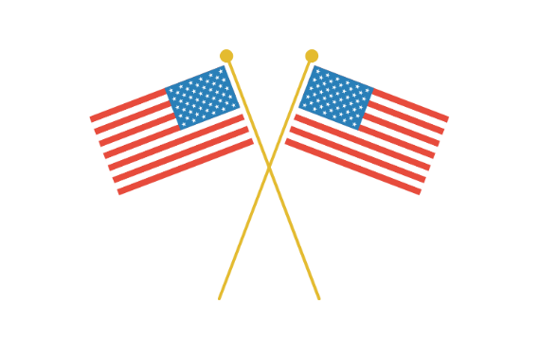
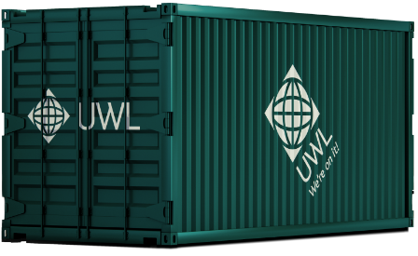
Part of
American
60+ Years
Owned
Family owned
Ocean
Container
Habitual
Pioneers
Innovators
Since the earliest days
Driven by customer needs

Slide 3
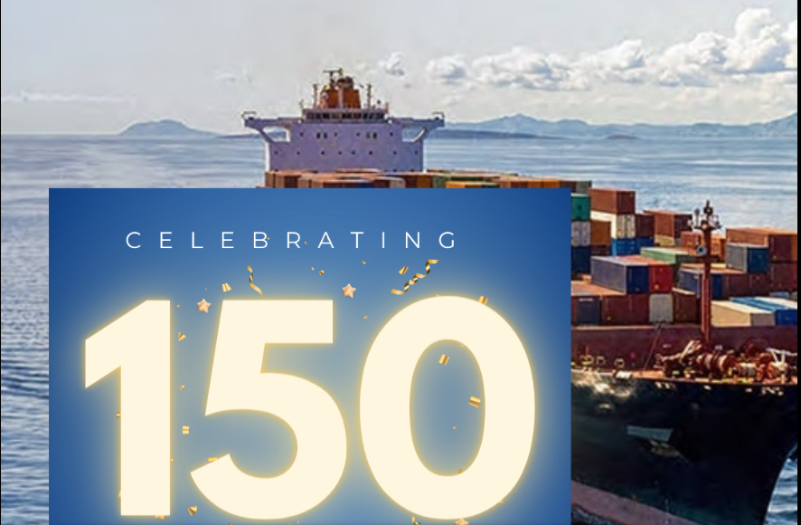
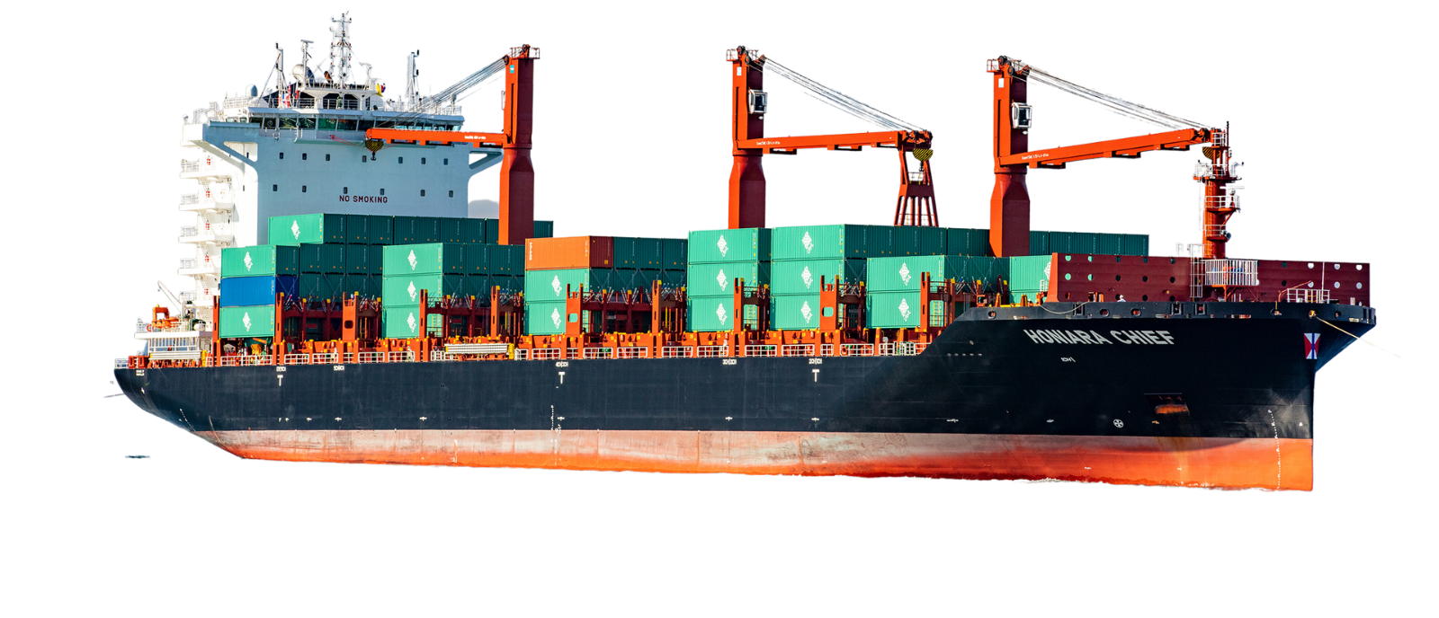
Over 200 years, Swire has grown into a highly diversified business group, guided by a commitment to operational excellence and a forward-looking approach.
Built for Purpose Eco Vessels
Optimized with naval architects the youngest, state-of-the-art, eco vessels with best-in-class fuel efficiency of any container ship in its class

Slide 4
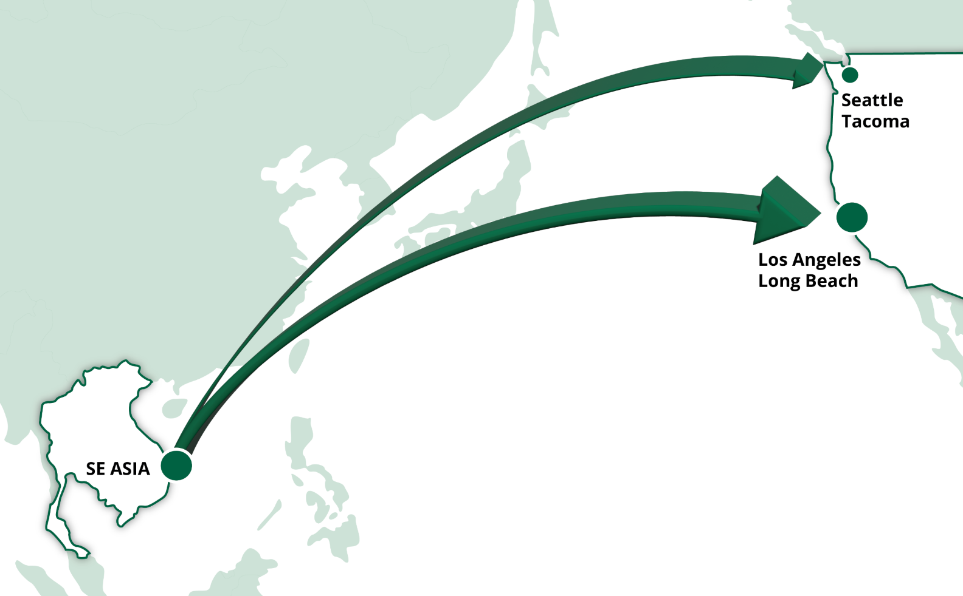
Flying Scotsman
Current: 22 Million TEUs into LA/LGB vs 3 Million TEU into SEA/TAC.
Strategy: Capture market share and have cargo move from SE Asia to Seattle-Tacoma instead of LA-LB for inland USA transload and distribution

Slide 5
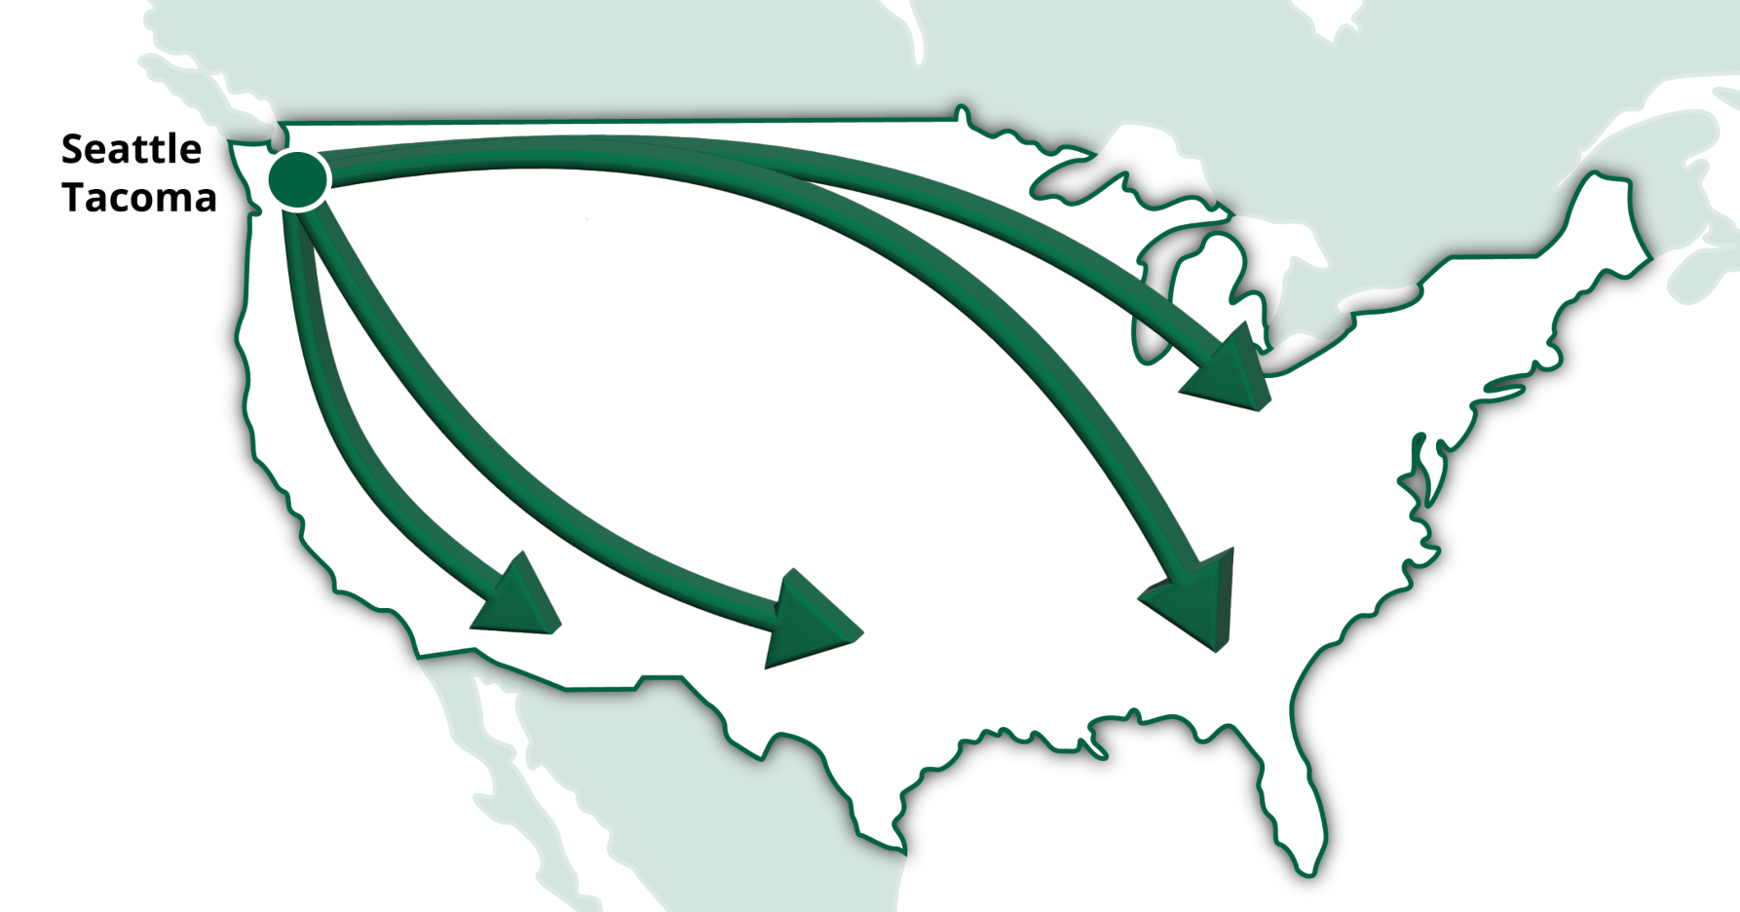
Flying Scotsman IPI & Trucking – 100% Nationwide Access
UWL Logistics End-to-End Services.
Partners with the UP & NS domestically, as well as both Canadian railroads.
Extensive trucking relationships and brokerage teams
Access to 100% of the nation!
80% of cargo leaves USWC via OTR or Intermodal 53's.
Can support any customer anywhere!

Slide 6
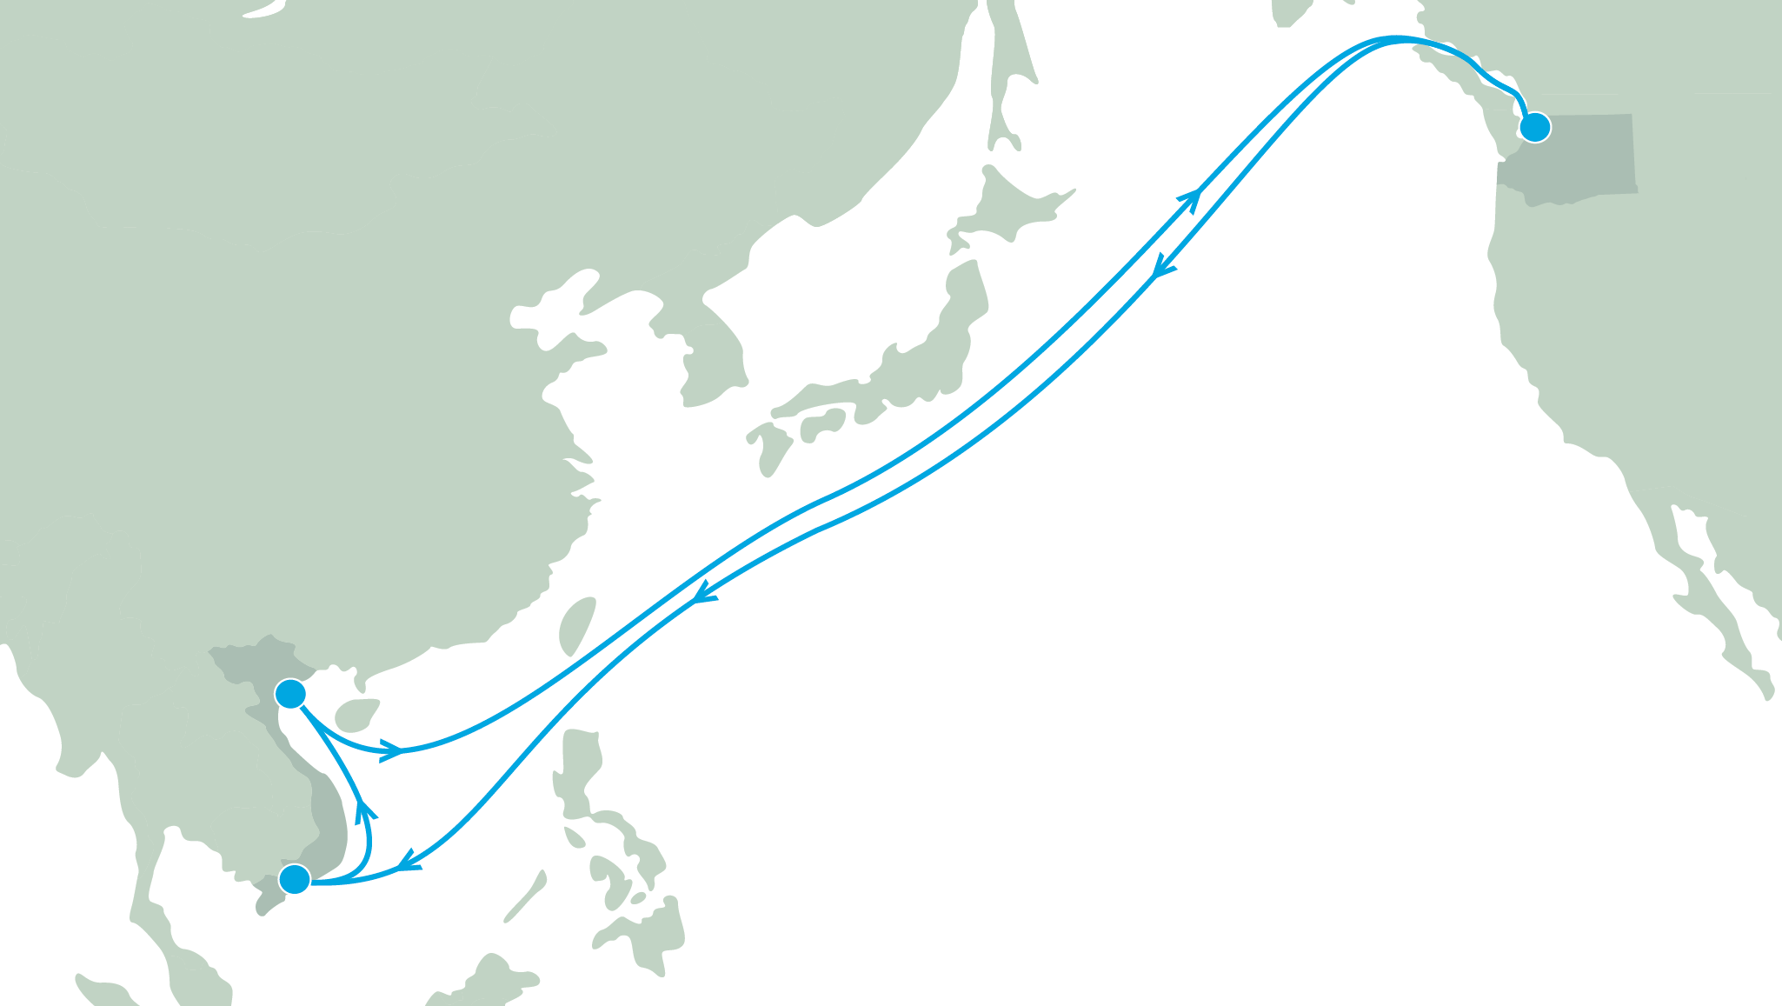
Seattle
What are we doing?
New & revolutionary:
We are incredibly excited to introduce something completely new and revolutionary to the trade at a time when the market needs it most. UWL is contracting with Swire Shipping to launch the first ever dedicated ocean service by an NVOCC in the trade - a premium 16-day shuttle service between Vietnam and Seattle.
Haiphong
Our vision:
Ho Chi Minh
Our goal is to support underserviced trades with dedicated, express, premium services that add reliable, guaranteed capacity to the trade.

Slide 7
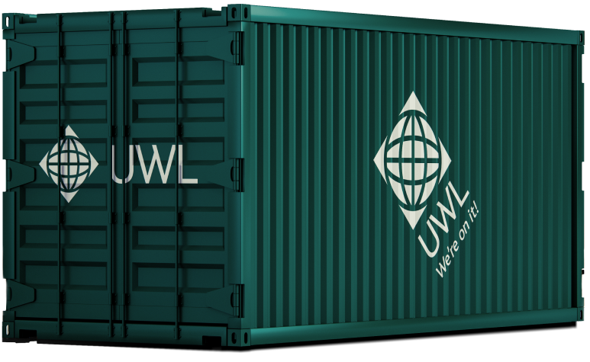
Export Product
[ Fastest transit time in the market ]
19
DAYS
SEATTLE TO
VIETNAM

Slide 8
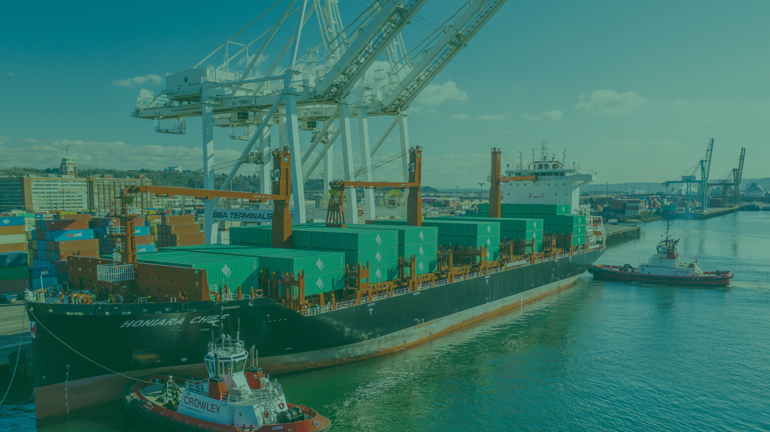
Supply Chain Solutions & Logistics Services - We're on it!

